Slide 1
How to best use these slides…
View the PPT as a slide show
Then click through every step
Mouse clicks will advance the slide show
Left/right arrow keys move forward/backward
Mouse wheel scrolling moves forward/backward
When a question is posed, stop and think it through, try to answer it yourself before clicking
If you have questions, email me, ask in the Teams Student Center channel!

Slide 2
LESSON 6. 2
The Natural Base e

Slide 3
Today you will:
Learn what the Natural Base e is, and how it is used in real-world problems.
Graph natural base exponential functions and interpret them.
Practice using English to describe math processes and equations

Slide 4
Core Vocabulary:
Natural base e, p. 304
Previous:
Irrational number
Properties of exponents
Percent increase/decrease
Compound interest

Slide 5
Can you name some of the special numbers we have worked with?
Pi
$π$
~3.1415962
an irrational number
the circumference of a circle divided by its diam
$i$
$\sqrt{−1}$
the imaginary number
found all over the place for example in electronics

Slide 6
Today we learn a new one!
$e$
Called the “natural base” (we will see why in a few days)
~2.718281828
Easy to remember: 2.7 1828 1828
An irrational number
Turns out to be a very common number! For example, used in finance.
Also called “Euler’s number” after the mathematician who discovered it.
…by the way, Euler is pronounced “oiler” ☺
The Natural Base

Slide 7
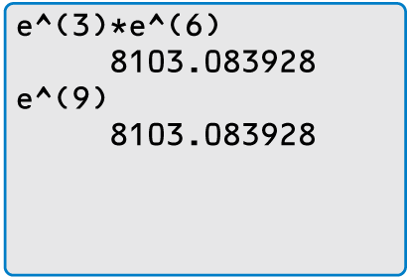
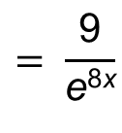
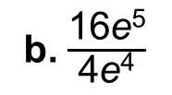
Check
Simplify each expression.
You can use a calculator to check the equivalence of numerical expressions involving e.
a. $\text{e}\text{3} \text{•} \text{e}\text{6}$
b. $\frac{\text{16}\text{e}\text{5}}{\text{4}\text{e}\text{4}}$
c.$\text{(3}\text{e}\text{−}\text{4}\text{x}\text{)}\text{2}$
SOLUTION
a. $\text{e}\text{3} \text{•} \text{e}\text{6}$ $=\text{e}\text{3}+\text{6}$
b. $\frac{\text{16}\text{e}\text{5}}{\text{4}\text{e}\text{4}}=\text{4}\text{e}\text{5 }\text{−} \text{4}$
c.$\text{(3}\text{e}\text{−}\text{4}\text{x}\text{)}\text{2}=\text{3}\text{2}\text{(}\text{e}\text{−}\text{4}\text{x}\text{)}\text{2}$
$$=\text{e}\text{9}$$
$$=\text{4}\text{e}$$
$$=\text{9}\text{e}\text{−}\text{8}\text{x}$$
$$= \frac{\text{9}}{\text{e}\text{8}\text{x}}$$
…these are very simple, just pretend $e$ is a variable and simplify!
…just remember it is *NOT* a variable, it is 2.718281828…

Slide 8
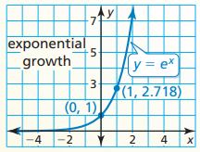
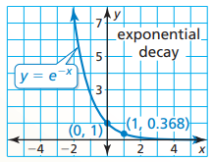
Natural Base Exponential Functions
Exponential functions using the natural base $e$ as the base of the exponent.
Generalize form:
When $a>0$ and $r>0$, the function is an exponential growth function.
When $a>0$ and $r<0$, the function is an exponential decay function.
$$y=ae^{rt}$$

Slide 9
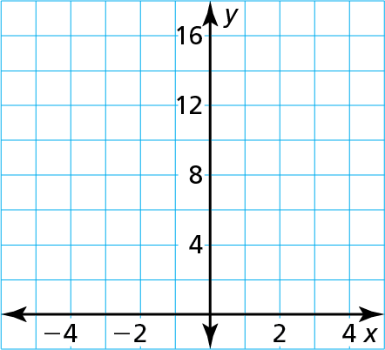
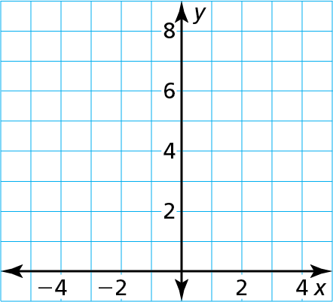
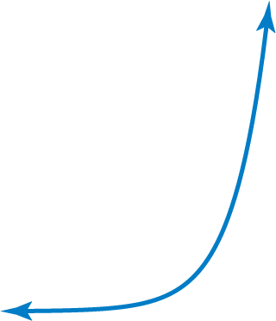
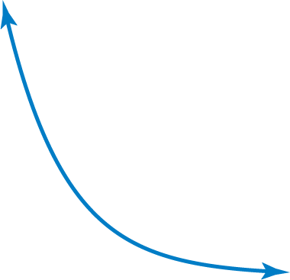
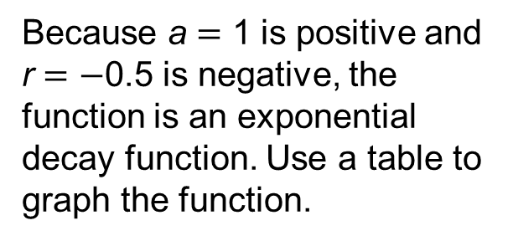
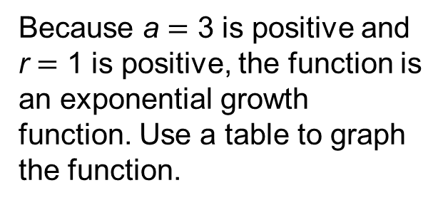
Tell whether each function represents exponential growth or exponential decay. Then graph the function.
a. y $=\text{3}\text{e}$^{x}
b. f(x) $=$ e^{−0.5x}
SOLUTION
You can rewrite natural base exponential functions to find percent rates of change. In Example 2(b),
a.
Because a $=$ 3 is positive and r $=$ 1 is positive, the function is an exponential growth function. Use a table to graph the function.
b.
Because a $=$ 1 is positive and r $=$ $−$0.5 is negative, the function is an exponential decay function. Use a table to graph the function.
f(x) $=$ e^{−0.5x}
x | $−$2 | $−$1 | 0 | 1
y | 0.41 | 1.10 | 3 | 8.15
x | $−$4 | $−$2 | 0 | 2
y | 7.39 | 2.72 | 1 | 0.37
$=$ (e^{−0.5})^{x}
≈ (0.6065)^{x}
= (1 − 0.3935)^{x}.
So, the percent decrease is about 39.35%.

Slide 10
Use the properties of exponents to rewrite the function in the form $y=a(1+r)^{t}$ or $y=a(1−r)^{t}$. Then find the percent rate of change. Round to three decimal places.
$$y=e^{−0.75t}$$
SOLUTION
$$y=e^{−0.75t}$$
$r=−0.75$ (less than 1) so this is decay
$y={(e^{−0.75})}^{t}$
Use power of a power property
$y={(.4723665527)}^{t}$
Simplify
$$.4723665527=1−r$$
$b≈.472366527$ and $b=(1−r)$
$$r≈.528$$
Solve for $r$
The function is $y=(1−0.528)^{t}$ and the rate of decay is .528 or 52.8%.

Slide 11
Use the properties of exponents to rewrite the function in the form $y=a(1+r)^{t}$ or $y=a(1−r)^{t}$. Then find the percent rate of change. Round to three decimal places.
$$y={0.5e}^{0.8t}$$
SOLUTION
$$y={0.5e}^{0.8t}$$
$r=0.8$ (greater than 1) so this is growth
$y={0.5(e^{0.8})}^{t}$
Use power of a power property
$y=0.5{(2.2255)}^{t}$
Simplify
$$2.2255=1+r$$
$b≈2.2255$ and $b=(1−r)$
$$r≈1.2255$$
Solve for $r$
The function is $y=(1+1.226)^{t}$ and the rate of growth is 1.226 or 122.6%.

Slide 12
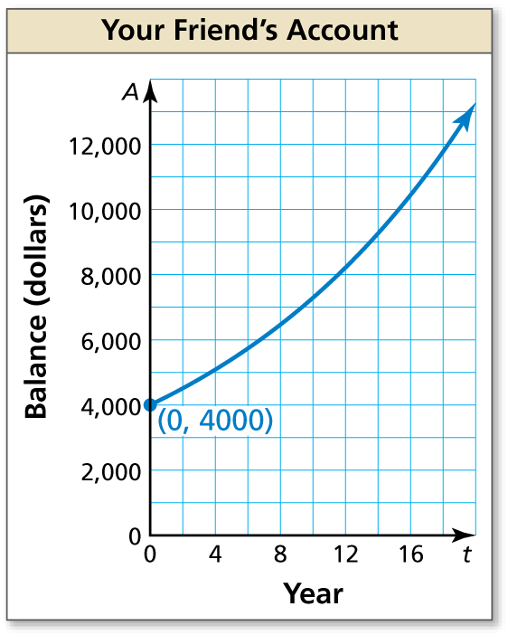
You and your friend each have accounts that earn annual interest compounded continuously. The balance A (in dollars) of your account after t years can be modeled by A $=$ 4500e^{0.04t}. The graph shows the balance of your friend’s account over time. Which account has a greater principal? Which has a greater balance after 10 years?
SOLUTION
1. Understand the Problem You are given a graph and an equation that represent account balances. You are asked to identify the account with the greater principal and the account with the greater balance after 10 years.
2. Make a Plan Use the equation to find your principal and account balance after 10 years. Then compare these values to the graph of your friend’s account.
3. Solve the Problem The equation A $=$ 4500e^{0.04t} is of the form A = Pe^{rt}, where P $=$ 4500. So, your principal is $4500. Your balance A when t $=$ 10 is
A $=$ 4500e^{0.04(10)} $=$ $6713.21.
Because the graph passes through (0, 4000), your friend’s principal is $4000. The graph also shows that the balance is about $7250 when t $=$ 10.
So, your account has a greater principal, but your friend’s account has a greater balance after 10 years.

Slide 13
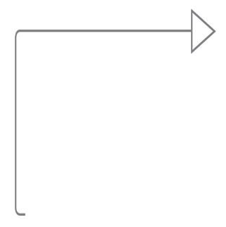
4. Look Back Because your friend’s account has a lesser principal but a greater balance after 10 years, the average rate of change from t $=$ 0 to t $=$ 10 should be greater for your friend’s account than for your account.
Your account: $\frac{\text{A}\text{(10)} \text{−} \text{A}\text{(0)}}{\text{10} − \text{0}}$ $=$ $\frac{\text{6713.21} − \text{4500}}{\text{10}}$ $=$ 221.321
You can also use this
reasoning to conclude that
your friend’s account has
a greater annual interest
rate than your account.
Your friend’s account: $\frac{\text{A}\text{(10)} − \text{A}\text{(0)}}{\text{10} − \text{0}}$ $≈$ $\frac{\text{7250 }− \text{4}\text{0}\text{00}}{\text{10}}$ $=$ 325

Slide 14
Homework
Pg 307, #3-35 odd

